Slide 1


Final Project Progress Report
COVID-19 Topic modeling with LDA
0852627 Amri Muhaimin
0852628 Dwilaksana Abdullah Rasyid

Slide 2


Crawling Result
Keywords:
Tools
“COVID-19”
“2019-nCoV”
“SARS-nCOV-2”
“SARS-COV-2”
Paper that contain abstract
citescore => 1

Slide 3
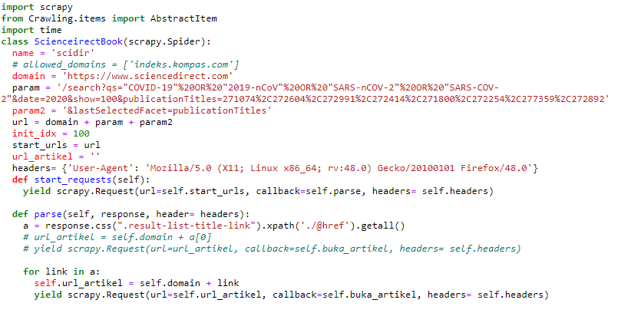
Crawling Result

Slide 4
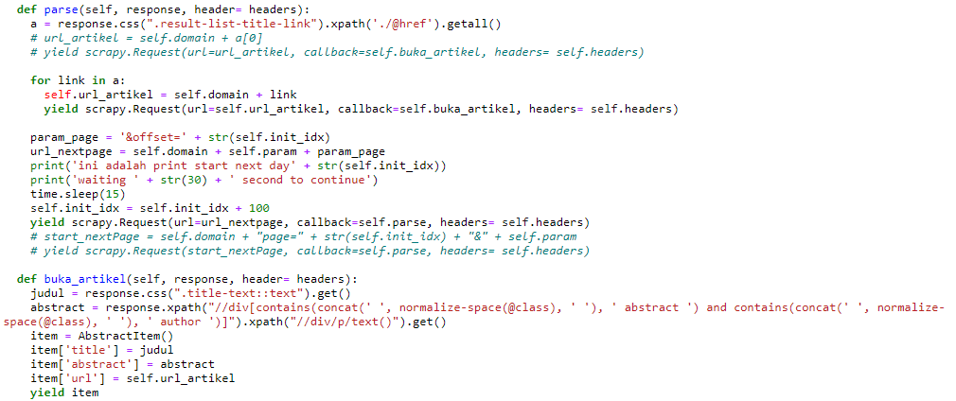
Crawling Result

Slide 5
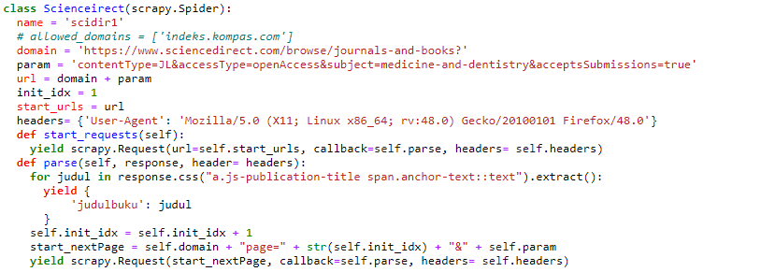
Crawling Result

Slide 6
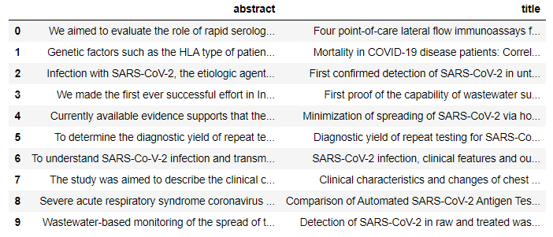

Crawling Result

